Slide 1
US Decision Science
Osteoporosis Targeting Assessment
June 2007

Slide 2
Objective
Review actual coverage by customer decile, TRx and NRx versus recommended coverage by tier, down to the territory level.
Understand potential causes for gaps between actual and recommended coverage
  Capacity
  Business shift
  Field implementation
Make recommendations for action based upon analysis

Slide 3
Business Rules: Orion Targeting Algorithm (Dec 2006)
Primary Care
Specialty should exclude IM with Forteo 3-10, END, RHU
  T1 (High OBG Customers (15))
    1. Specialty (OBG, then PCP)
    2. Bone Decile
    3. Inverse HRT decile (lowest HRT decile first)
  T2 (High Forteo Customer (5))
    1. Forteo Decile
    2. Bone Decile
  T3 (Evista PCP/OBG & Forteo Decile 1-2 (45))
    1. Evista Decile
    2. Forteo Decile
    3. Bone Decile
  T4 (Mid Evista, Forteo NT prioritized by PAQ (25))
    1. Evista 3-10 first, then Evista 1-2
    2. PAQ
    3. Bone Decile
Specialty
Specialty should only include IM with Forteo 3-10, END, RHU, Osteo Orthopaedic Surgeons, Physiatrists, Hospitalists
  T1 (Adopters (10))
    1. Forteo Decile
    2. Bone Decile
  T2 (Top Growing Triers (10))
    1. Forteo Decile
    2. Bone Decile
  T3 (Growing Triers (20))
    1. Forteo Decile
    2. Bone Decile
  T4 (Non-writing TLs, Osteo Orthopaedic Surgeons, Physiatrists, Hospitalists (5))
    use IMS specialty to select Osteo Orthopaedic Surgeons, Physiatrists, and Hospitalists only – reps will need to add TLs

Slide 4
Definitions and Assumptions
Recommended coverage: coverage based upon original target list build
Actual coverage: Osteo-PC and Osteo-Specialty Laptop data as of May 1, 2007
TRx, NRx, and 3 month deciles use data from Feb-Apr 2007
NH customers are excluded, and the results reflect zero TRx/NRx in NH
3Q 2007 TTP rules were used to exclude non-TTP customers, rather than using the TTP file to perform this exclusion

Slide 5
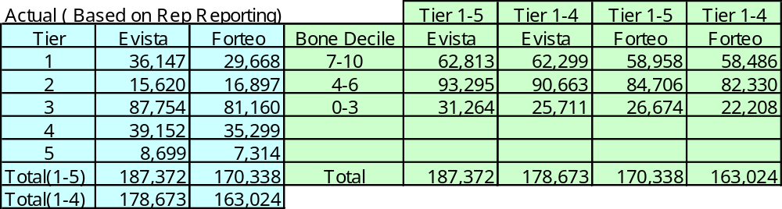
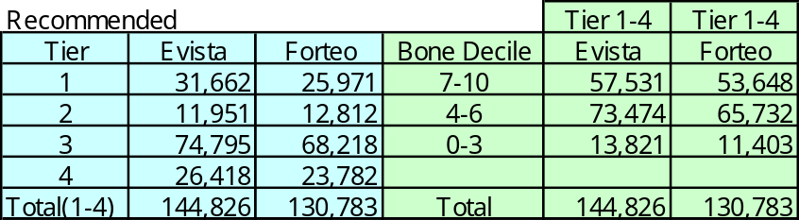
Brand Details vs. Initial Recommendations-PCP
There are significantly more details in implementation than in the recommendation for Tiers 1-4

Slide 6
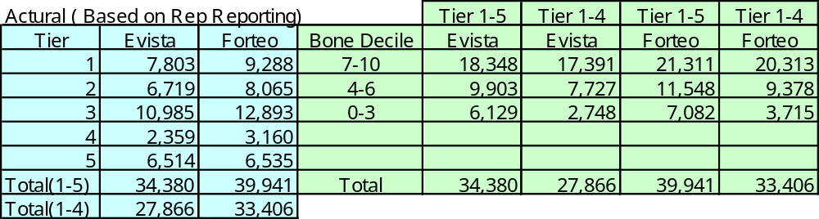
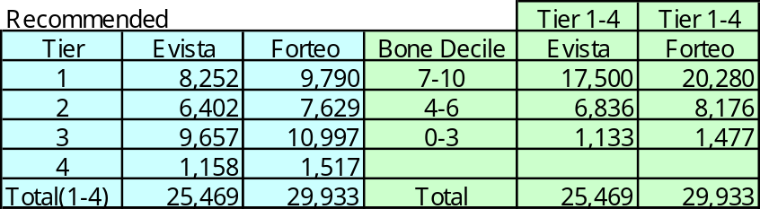
Brand Details vs. Initial Recommendations -SPC
There are slightly more details in implementation than in the recommendation for Tiers 1-4

Slide 7
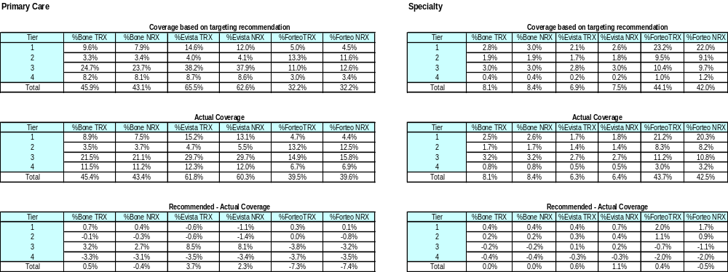
Coverage by Tier
% of (Tier 1-4) Rxs / Total MDs Rxs in Bone Dec 1-10
Specialty Rx: Rx coverage difference between recommendation and actual is not significant
PCP Rx: Actual targeting has less Evista Rx coverage and more Forteo Rx than recommendation

Slide 8
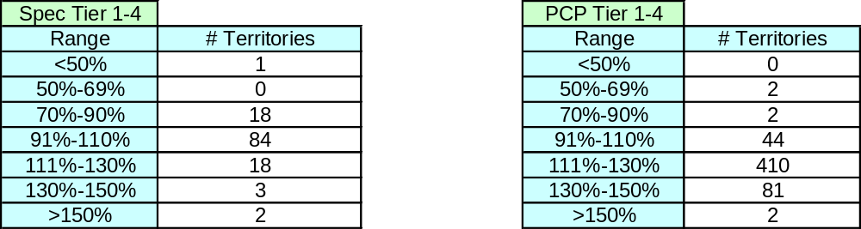
Capacity Analysis
% of Actual Calls to Tier 1-4 compared to recommended
Specialty
Capacity calculation assumes 3x per month for T1-2, 2x per month for T3, and 1x/month for T4
Total calls/quarter capacity is 408
19% of territories are above 110%
PCP
Capacity calculation assumes 2x per month for T1, 3x/month for T2, 2x per month for T3, and 1x/month for T4
Total calls/quarter capacity is 459
91% of territories are above 110%

Slide 9
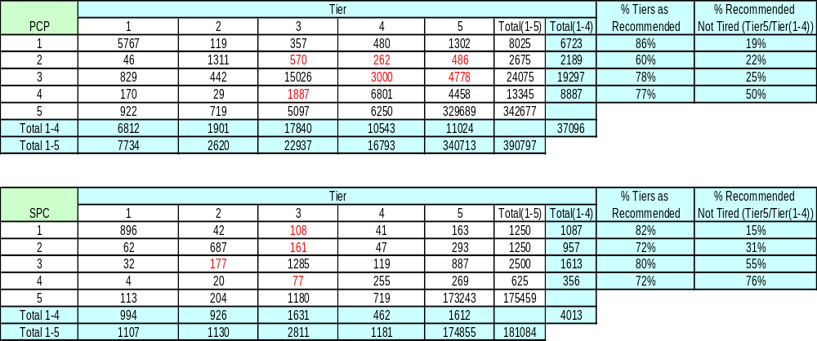
Analysis of Field Involvement
Laptop Tier ( May, 2007)
Recommended
Tier
Red: Tiers that are 10% or more away from the recommendation

Slide 10
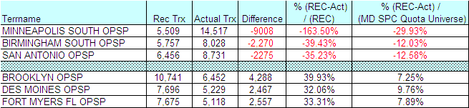
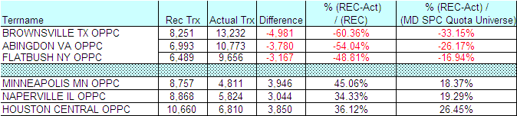
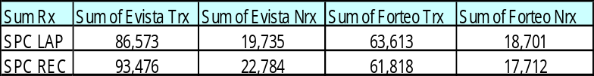
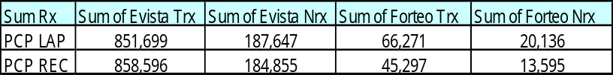
Actual and Recommended TRx: Total & Outliers
Specialty
PCP
Actual PCP coverage has slightly more Bone Rxs than Recommended. No significant difference in Rx coverage in Specialty.
More Forteo Rxs in Actual than in Rec for Specialty and PCP
For Specialty, more Evista Nrx and Trx in Rec than in Actual
No significant Evista Rx difference between PCP Actual and Recommended

Slide 11
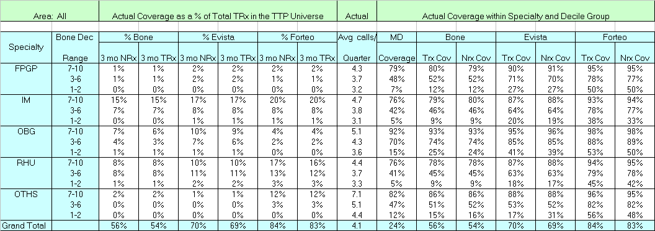
Coverage by Specialty for Bone Dec (Actual)
Example of how to read this table:
IM bone decile 7-10 covers 15% of total bone TRx, 17% of Evista TRx and 20% of Forteo TRx, ranks the first among all specialties, and the average calls/ per quarter are not significantly more than other specialties.

Slide 12
Summary and Recommendations
Overall implementation was very close to the plan in terms of TRx/NRx coverage
We need to understand why reps are tiering up more MDs than planned
  This could lead to lower coverage of the most valuable MDs
Need to increase coverage of IMs and Rheums
  These are the most valuable MDs, both in terms of promotion response and TRx/MD
  We are currently covering 76% of IM/Rheum 7-10s, and 41-42% of IM/Rheum 3-6s

Slide 13
Appendix

Slide 14
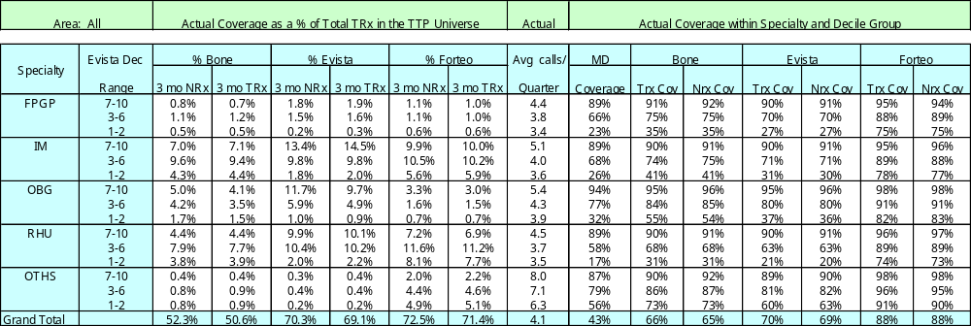
Coverage by Specialty for Evista Dec (Actual)

Slide 15
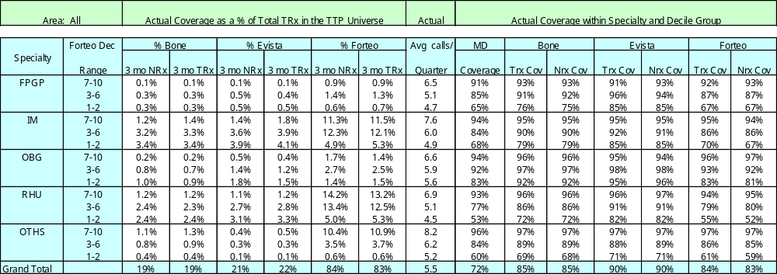
Coverage by Specialty for Forteo Dec (Actual)

Slide 16
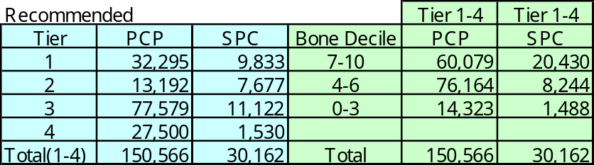
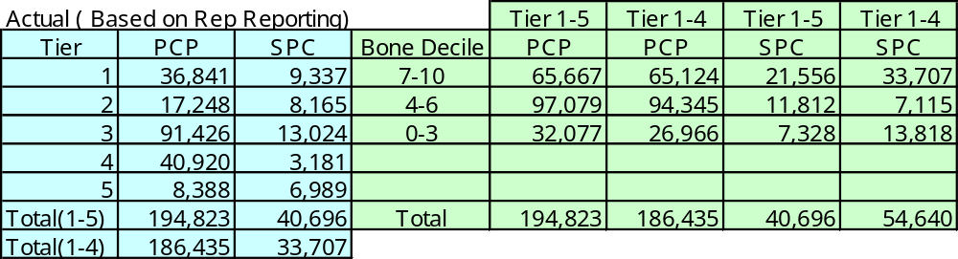
Brand Calls vs. Initial Recommendations

Slide 17
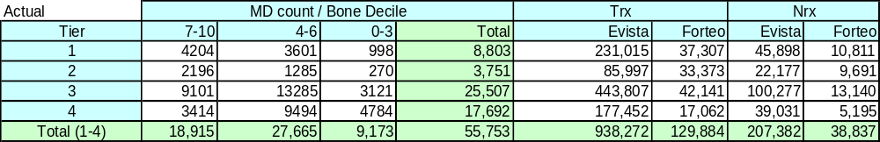
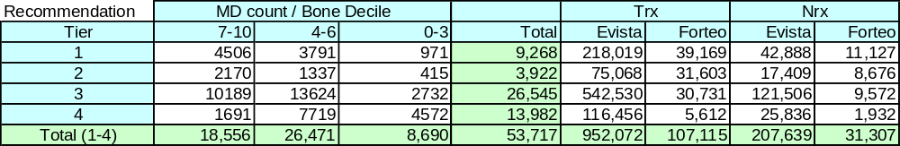
Analysis of Business Shift

Slide 18
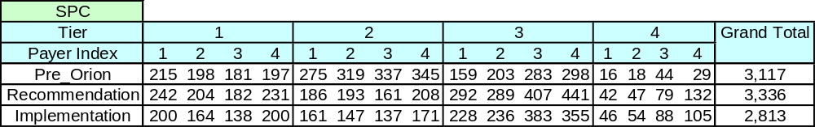
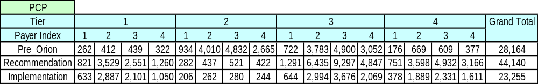
Payer Index by Tier

